Slide 1
物聯網系統設計與實作 Ameba_進階程式設計 (類比讀寫)
講師：曹永忠
國立台灣大學創新設計學院

Slide 2
Arduino 程式介紹

Slide 3
Arduino 程式架構
2017/11/2
3

Slide 4
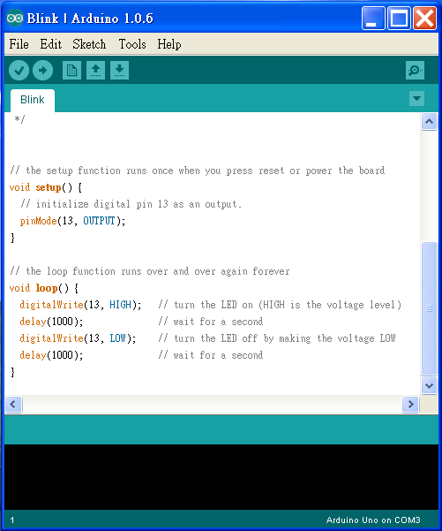
Arduino程式的介面
功能表

Slide 5
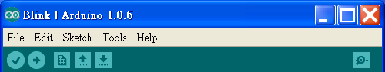
將程式燒入到
Arduino
開啟舊檔
回傳值
同等於C語言的Rebuild All
儲存檔案
開新檔案

Slide 6
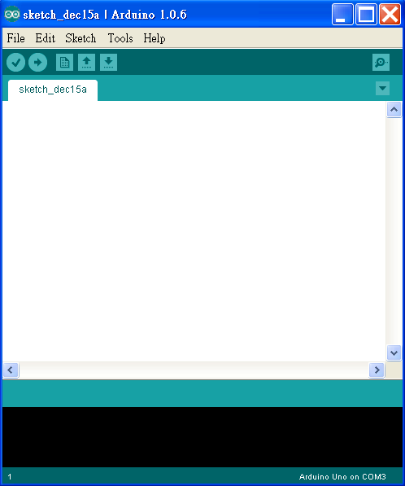
撰寫程式內容
要注意是否連線，
若未連線可以Rebuild但不可燒入

Slide 7
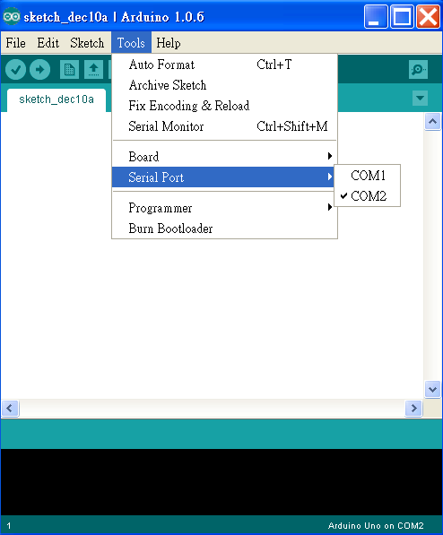
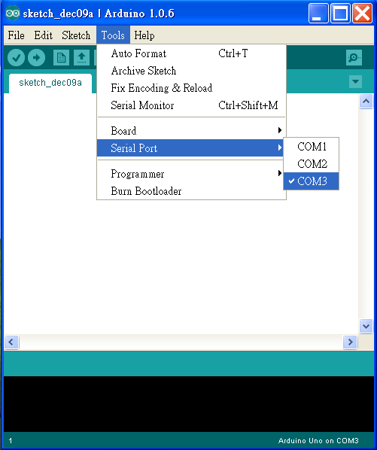
未連線
已連線

Slide 8
Arduino程式架構
(一.)宣告:
Arduino宣告方式與C相同,例如:int，float…
(二.)初始化 Setup():
使Arduino板子裝置妥當的指令
EX:
int ledPin=7; / 宣告Arduino7號腳為輸入腳/
Setup()
{
pinMode(ledPin,INPUT);
}

Slide 9
(三.)執行Loop():
為程式的主要內容,這程式內容會一直重複被執行
EX:
Loop()
{
……
}

Slide 10
(四.)函式:
1. pinMode(7,INPUT) //將腳位7設定為輸入模式
2. digitalWrite(8,HIGH) (數位腳專用)
//將腳位8設定輸出高電位
3. val=digitalRead(7) (數位腳專用)
//讀出腳位7的值並指定給 val變數

Slide 11
4.analogWrite(9,128) (數位訊號專用所設計的函式)
//將擁有PWM的數位腳位9 設定輸出電位2.5V對應值大 約為128
5. val=analogRead(0) (類比腳專用) //讀出腳位0的值並指定給 val變數(且analogRead可讀 取範圍0(0V)~1023(5V))

Slide 12
系統開發
2017/11/2
12

Slide 13
啟動開發環境
2017/11/2
13

Slide 14
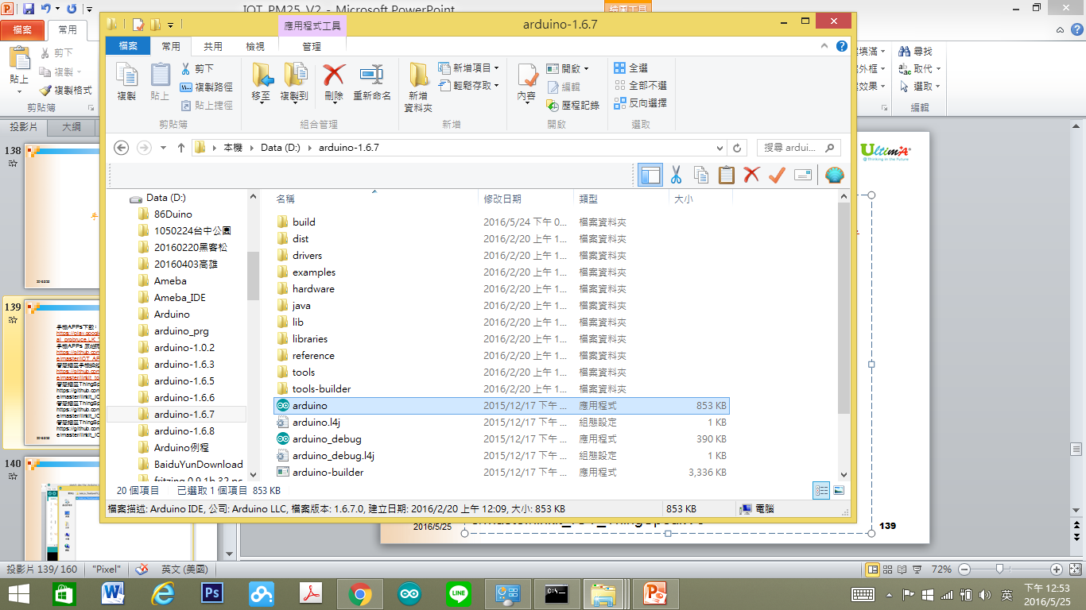
開啟程式
2017/11/2
14

Slide 15
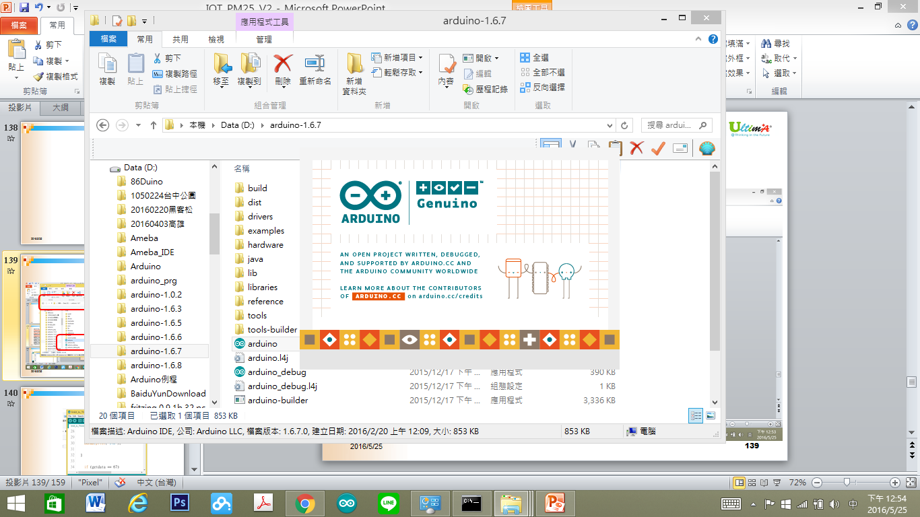
啟動程式
2017/11/2
15

Slide 16
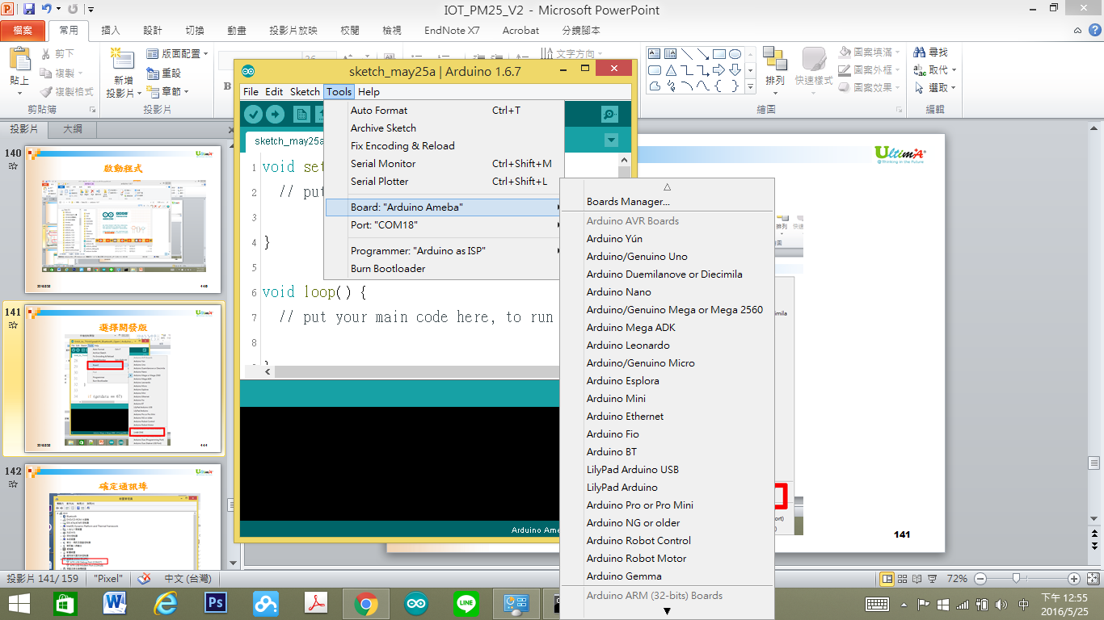
選擇開發版
2017/11/2
16

Slide 17
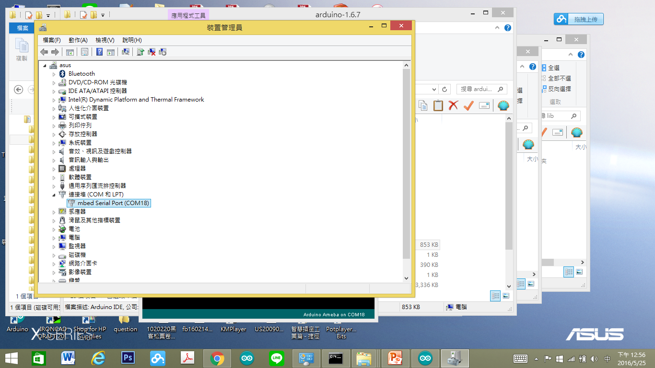
確定通訊埠
2017/11/2
17

Slide 18
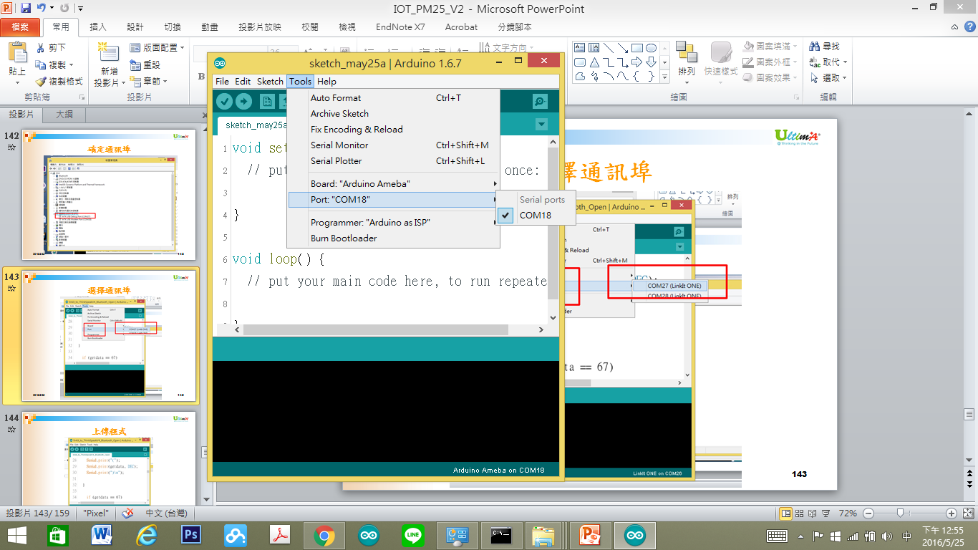
選擇通訊埠
2017/11/2
18

Slide 19
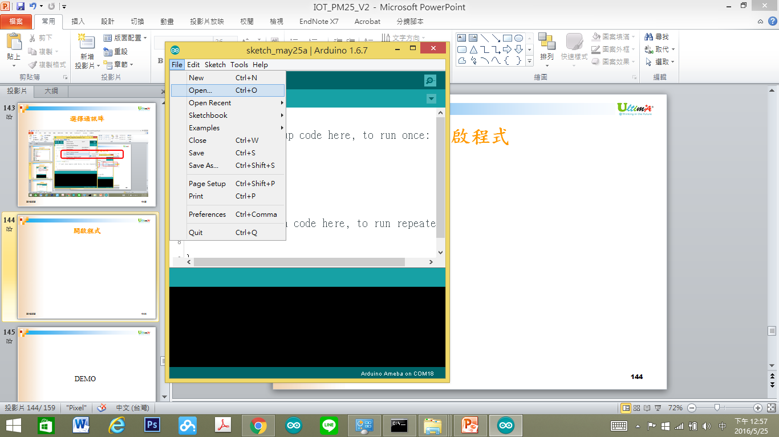
開啟程式
2017/11/2
19

Slide 20
Ameba 腳位說明
2017/11/2
20

Slide 21
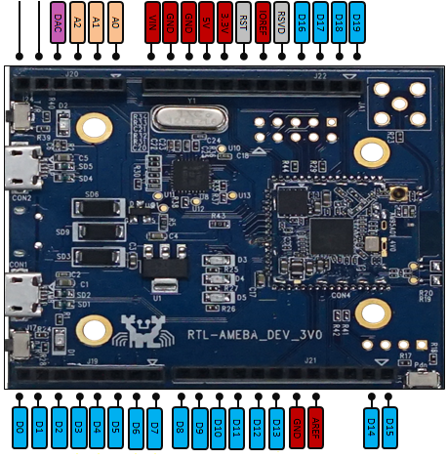
2017/11/2
21

Slide 22
簡單類比輸入模組
2017/11/2
22

Slide 23

類比搖桿元件
2017/11/2
23

Slide 24
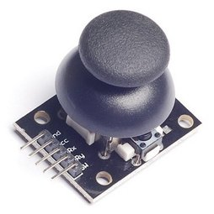
類比搖桿元件
2017/11/2
24

Slide 25
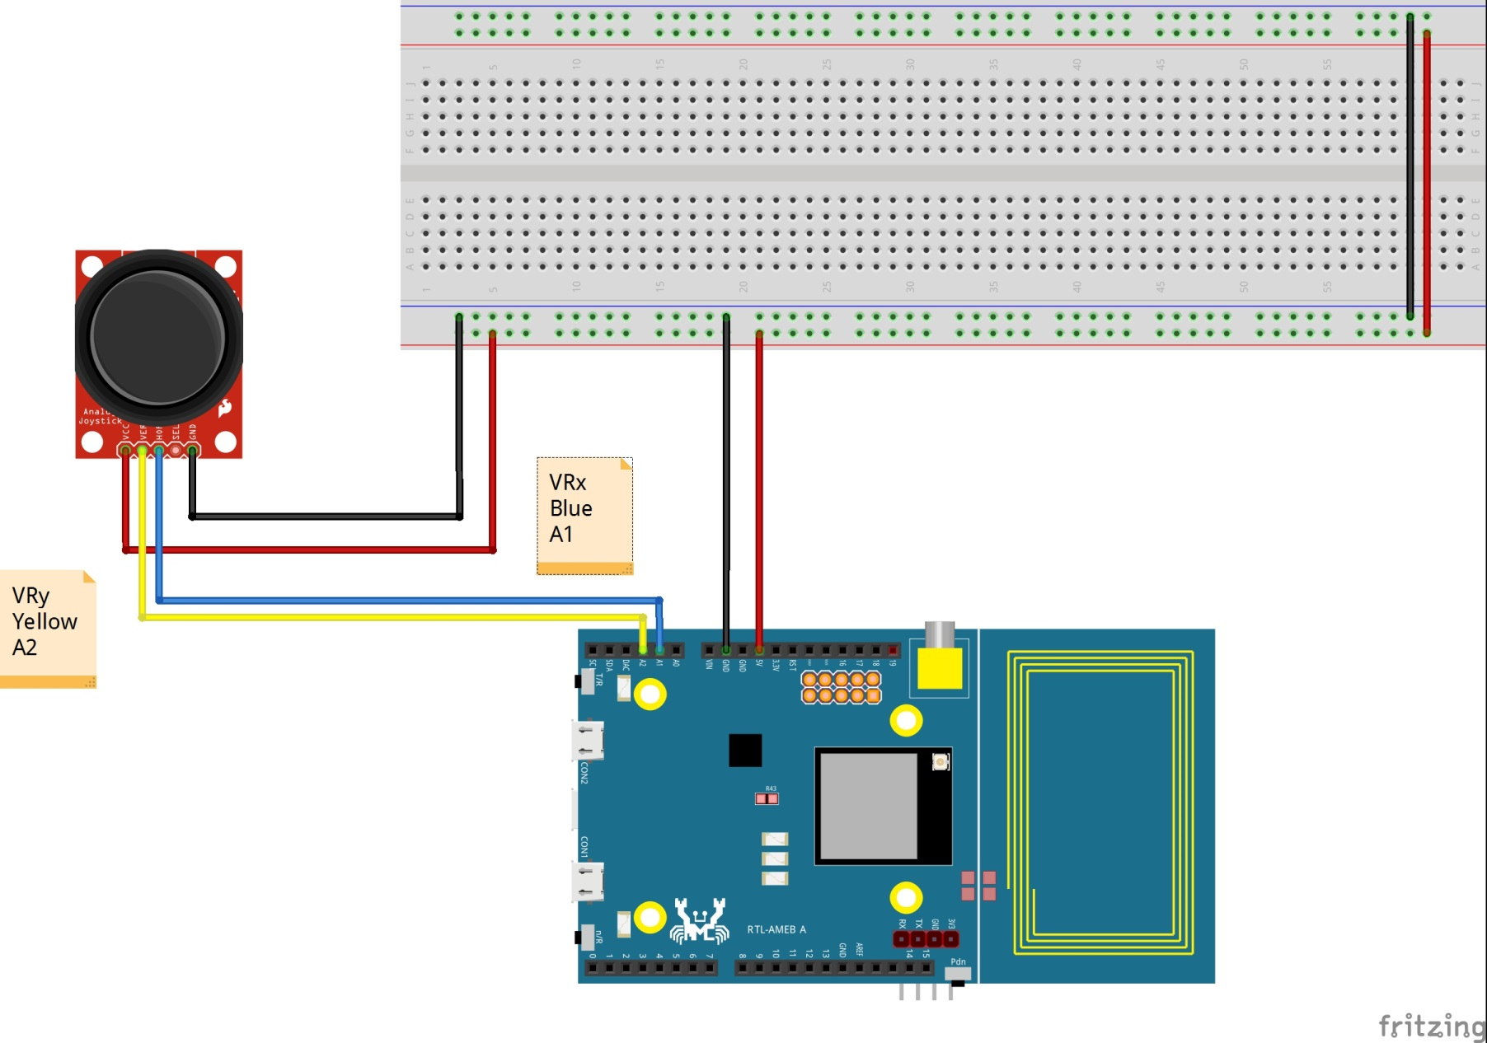
類比搖桿連接電路
2017/11/2
25

Slide 26
類比資料輸入
2017/11/2
26

Slide 27
讀取搖桿資料
2017/11/2
27

Slide 28
Joystick01
#define VRX 1
#define VRY 2
設定類比輸入接腳
2017/11/2
28
Notes:
設定類比輸入接腳

Slide 29
Joystick02
#define VRX 1
#define VRY 2
void setup() {
// put your setup code here, to run once:
Serial.begin(9600) ;
Serial.println("Program Start") ;
}
啟動監控通訊埠與通訊速度
2017/11/2
29
Notes:
啟動監控通訊埠與通訊速度

Slide 30
Joystick03
void loop() {
// put your main code here, to run repeatedly:
Serial.print("Read X is :(") ;
Serial.print(analogRead(VRX)) ;
Serial.print(") \n") ;
}
讀取類比輸入資料(X)
2017/11/2
30
Notes:
讀取類比輸入資料

Slide 31
Joystick04
Serial.print("Read Y is :(") ;
Serial.print(analogRead(VRY)) ;
Serial.print(") \n") ;
讀取類比輸入資料(Y)
2017/11/2
31
Notes:
設定類比輸入接腳

Slide 32

看不到X值
2017/11/2
32
Notes:
設定類比輸入接腳

Slide 33

看不到X值
2017/11/2
33
Notes:
設定類比輸入接腳

Slide 34
Joystick5
void loop() {
// put your main code here, to run repeatedly:
Serial.print("Read X is :(") ;
Serial.print(analogRead(VRX)) ;
Serial.print(") \n") ;
Serial.print("Read Y is :(") ;
Serial.print(analogRead(VRY)) ;
Serial.print(") \n") ;
delay(300) ;
}
加入延遲
2017/11/2
34
Notes:
加入延遲

Slide 35
簡單PWM輸出
2017/11/2
35

Slide 36

LED 元件
2017/11/2
36

Slide 37
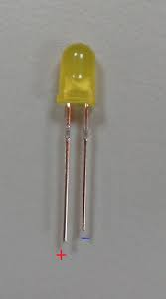
LED 元件
2017/11/2
37

Slide 38
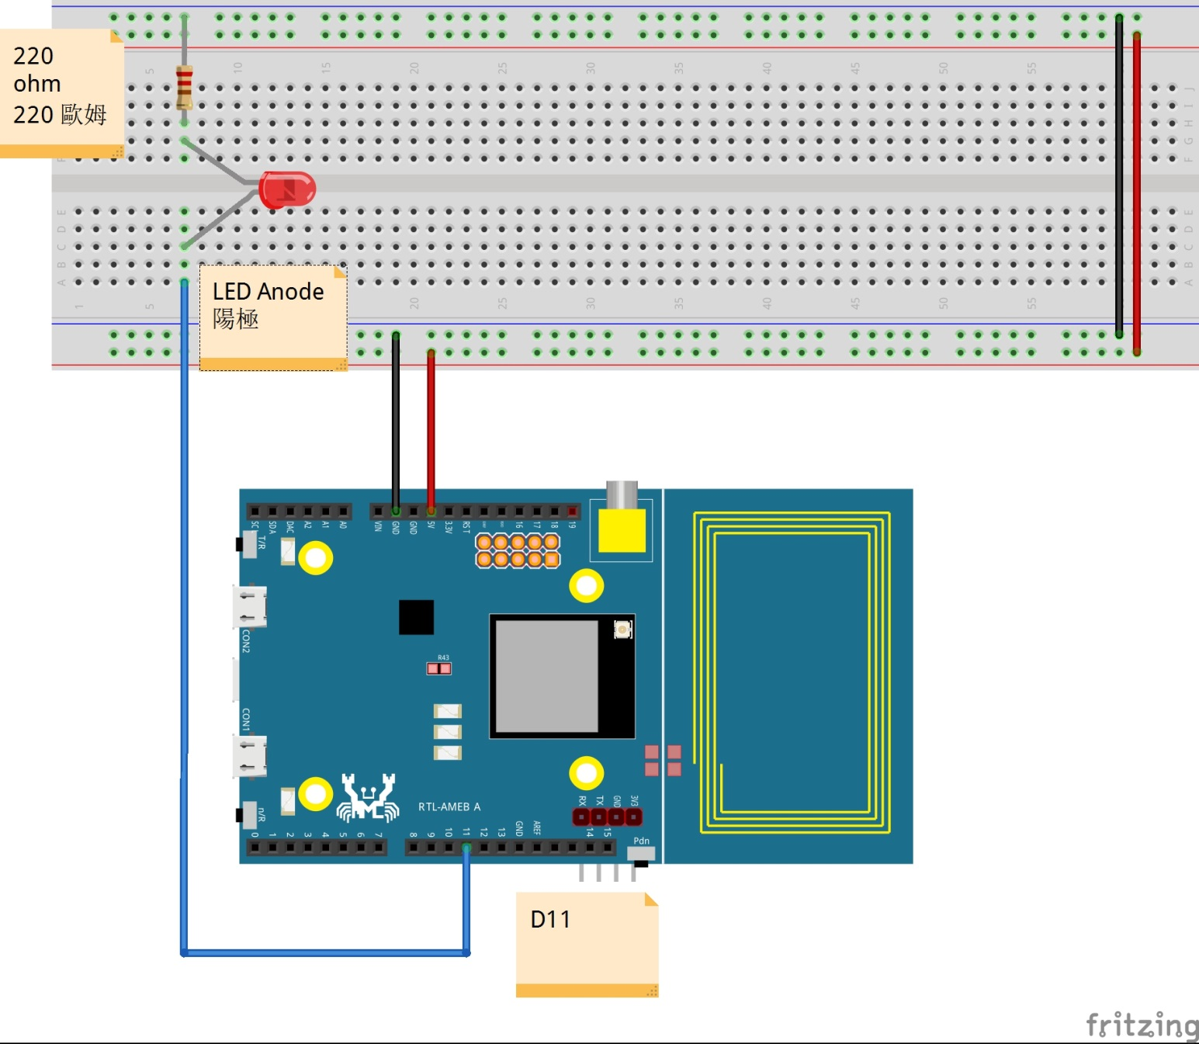
PWM連接電路
2017/11/2
38

Slide 39
類比資料輸出
2017/11/2
39

Slide 40
使用PWM驅動ＬＥＤ亮度
2017/11/2
40

Slide 41
ＬＥＤ ＰＷＭ０１
#define LED1 11
設定類比輸出接腳
2017/11/2
41
Notes:
設定類比輸入接腳

Slide 42
ＬＥＤ ＰＷＭ０２
analogWrite(LED, 50) ;
delay(1000) ;
analogWrite(LED, 220) ;
delay(1000) ;
1.輸出微亮
2.等一秒
3.輸出高亮度
4.等一秒
5.重複
2017/11/2
42
Notes:
啟動監控通訊埠與通訊速度

Slide 43
ＬＥＤ ＰＷＭ０３
#define LED1 11
int fadeValue = 0 ;
int fadeWay = 1 ;
void setup() {
analogWrite(LED1,fadeValue) ;
}
2017/11/2
43
Notes:
讀取類比輸入資料

Slide 44
ＬＥＤ ＰＷＭ０３
void loop() {
if (fadeValue >255)
{
fadeValue = 0 ;
fadeWay = 1 ;
}
if (fadeValue < 0 )
{
fadeValue = 255 ;
fadeWay = -1 ;
}
analogWrite(LED1,fadeValue) ; // change PWM
fadeValue += fadeWay ;
delay(30) ;
}
2017/11/2
44
Notes:
設定類比輸入接腳

Slide 45
簡單類比輸入與PWM輸出
2017/11/2
45

Slide 46
類比搖桿元件
2017/11/2
46

Slide 47
LED 元件
2017/11/2
47

Slide 48
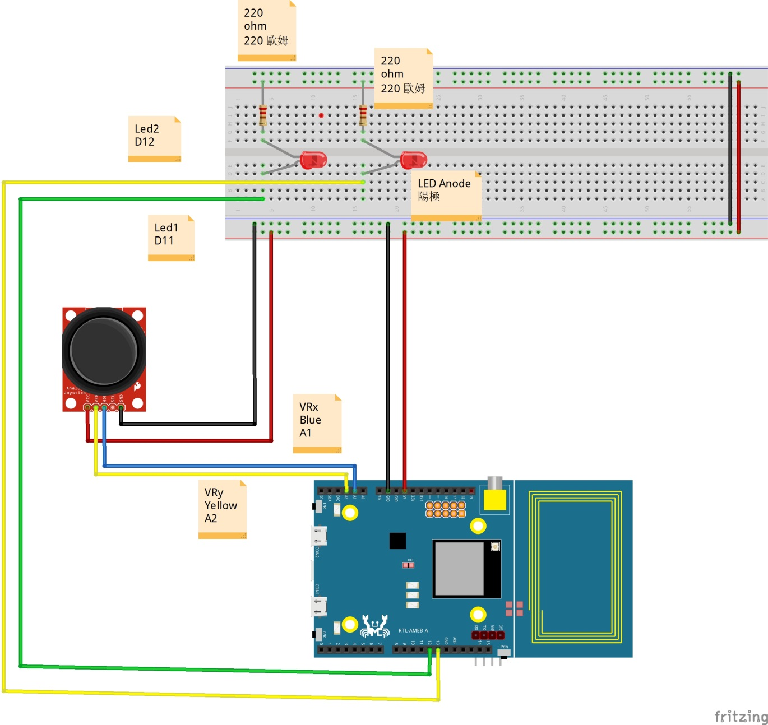
類比輸入與PWM輸出連接電路（兩路）
2017/11/2
48

Slide 49
兩路輸出控制兩路ＰＷＮ輸出
2017/11/2
49

Slide 50
使用PWM驅動ＬＥＤ亮度
2017/11/2
50

Slide 51
Joystick_PWM01
#define VRX A1
#define VRY A2
#define LED1 11
#define LED2 12
void setup() {
// put your setup code here, to run once:
Serial.begin(9600) ;
Serial.println("Program Start") ;
}
2017/11/2
51
Notes:
#define VRX A1
#define VRY A2
#define LED1 11
#define LED2 12
void setup() {
// put your setup code here, to run once:
Serial.begin(9600) ;
Serial.println("Program Start") ;
}
void loop() {
// put your main code here, to run repeatedly:
Serial.print("Read X is :(") ;
Serial.print(analogRead(VRX)) ;
Serial.print(") \n") ;
Serial.print("Read Y is :(") ;
Serial.print(analogRead(VRY)) ;
Serial.print(") \n") ;
delay(300) ;
}

Slide 52
Joystick_PWM01
void loop() {
// put your main code here, to run repeatedly:
Serial.print("Read X is :(") ;
Serial.print(analogRead(VRX)) ;
Serial.print(") \n") ;
Serial.print("Read Y is :(") ;
Serial.print(analogRead(VRY)) ;
Serial.print(") \n") ;
delay(300) ;
}
2017/11/2
52
Notes:
#define VRX A1
#define VRY A2
#define LED1 11
#define LED2 12
void setup() {
// put your setup code here, to run once:
Serial.begin(9600) ;
Serial.println("Program Start") ;
}
void loop() {
// put your main code here, to run repeatedly:
Serial.print("Read X is :(") ;
Serial.print(analogRead(VRX)) ;
Serial.print(") \n") ;
Serial.print("Read Y is :(") ;
Serial.print(analogRead(VRY)) ;
Serial.print(") \n") ;
delay(300) ;
}

Slide 53
Joystick_PWM02
#define VRX A1
#define VRY A2
#define LED1 11
#define LED2 12
int rx = 0 ;
int ry = 0 ;
void setup() {
// put your setup code here, to run once:
Serial.begin(9600) ;
Serial.println("Program Start") ;
}
2017/11/2
53
Notes:
#define VRX A1
#define VRY A2
#define LED1 11
#define LED2 12
int rx = 0 ;
int ry = 0 ;
void setup() {
// put your setup code here, to run once:
Serial.begin(9600) ;
Serial.println("Program Start") ;
}
void loop() {
// put your main code here, to run repeatedly:
Serial.print("Read X is :(") ;
Serial.print(analogRead(VRX)) ;
Serial.print(") \n") ;
Serial.print("Read Y is :(") ;
Serial.print(analogRead(VRY)) ;
Serial.print(") \n") ;
delay(300) ;
}

Slide 54
Joystick_PWM02
void loop() {
// put your main code here, to run repeatedly:
Serial.print("Read X is :(") ;
Serial.print(analogRead(VRX)) ;
Serial.print(") \n") ;
Serial.print("Read Y is :(") ;
Serial.print(analogRead(VRY)) ;
Serial.print(") \n") ;
delay(300) ;
}
2017/11/2
54
Notes:
#define VRX A1
#define VRY A2
#define LED1 11
#define LED2 12
int rx = 0 ;
int ry = 0 ;
void setup() {
// put your setup code here, to run once:
Serial.begin(9600) ;
Serial.println("Program Start") ;
}
void loop() {
// put your main code here, to run repeatedly:
Serial.print("Read X is :(") ;
Serial.print(analogRead(VRX)) ;
Serial.print(") \n") ;
Serial.print("Read Y is :(") ;
Serial.print(analogRead(VRY)) ;
Serial.print(") \n") ;
delay(300) ;
}

Slide 55
Joystick_PWM03
#define VRX A1
#define VRY A2
#define LED1 11
#define LED2 12
int rx = 0 ;
int ry = 0 ;
void setup() {
// put your setup code here, to run once:
Serial.begin(9600) ;
Serial.println("Program Start") ;
}
2017/11/2
55
Notes:
#define VRX A1
#define VRY A2
#define LED1 11
#define LED2 12
int rx = 0 ;
int ry = 0 ;
void setup() {
// put your setup code here, to run once:
Serial.begin(9600) ;
Serial.println("Program Start") ;
}
void loop() {
// put your main code here, to run repeatedly:
rx = analogRead(VRX) ;
ry = analogRead(VRY) ;
Serial.print("Read X is :(") ;
Serial.print(analogRead(VRX)) ;
Serial.print(") \n") ;
Serial.print("Read Y is :(") ;
Serial.print(analogRead(VRY)) ;
Serial.print(") \n") ;
delay(300) ;
}

Slide 56
Joystick_PWM03
void loop() {
// put your main code here, to run repeatedly:
rx = analogRead(VRX) ;
ry = analogRead(VRY) ;
Serial.print("Read X is :(") ;
Serial.print(analogRead(VRX)) ;
Serial.print(") \n") ;
Serial.print("Read Y is :(") ;
Serial.print(analogRead(VRY)) ;
Serial.print(") \n") ;
delay(300) ;
}
2017/11/2
56
Notes:
#define VRX A1
#define VRY A2
#define LED1 11
#define LED2 12
int rx = 0 ;
int ry = 0 ;
void setup() {
// put your setup code here, to run once:
Serial.begin(9600) ;
Serial.println("Program Start") ;
}
void loop() {
// put your main code here, to run repeatedly:
rx = analogRead(VRX) ;
ry = analogRead(VRY) ;
Serial.print("Read X is :(") ;
Serial.print(analogRead(VRX)) ;
Serial.print(") \n") ;
Serial.print("Read Y is :(") ;
Serial.print(analogRead(VRY)) ;
Serial.print(") \n") ;
delay(300) ;
}

Slide 57
Joystick_PWM01
void loop() {
// put your main code here, to run repeatedly:
Serial.print("Read X is :(") ;
Serial.print(analogRead(VRX)) ;
Serial.print(") \n") ;
Serial.print("Read Y is :(") ;
Serial.print(analogRead(VRY)) ;
Serial.print(") \n") ;
delay(300) ;
}
2017/11/2
57

Slide 58
Joystick_PWM01
void loop() {
// put your main code here, to run repeatedly:
Serial.print("Read X is :(") ;
Serial.print(analogRead(VRX)) ;
Serial.print(") \n") ;
Serial.print("Read Y is :(") ;
Serial.print(analogRead(VRY)) ;
Serial.print(") \n") ;
delay(300) ;
}
2017/11/2
58

Slide 59
Joystick_PWM01
void loop() {
// put your main code here, to run repeatedly:
Serial.print("Read X is :(") ;
Serial.print(analogRead(VRX)) ;
Serial.print(") \n") ;
Serial.print("Read Y is :(") ;
Serial.print(analogRead(VRY)) ;
Serial.print(") \n") ;
delay(300) ;
}
2017/11/2
59

Slide 60
Joystick_PWM01
void loop() {
// put your main code here, to run repeatedly:
Serial.print("Read X is :(") ;
Serial.print(analogRead(VRX)) ;
Serial.print(") \n") ;
Serial.print("Read Y is :(") ;
Serial.print(analogRead(VRY)) ;
Serial.print(") \n") ;
delay(300) ;
}
2017/11/2
60

Slide 61
Joystick_PWM01
void loop() {
// put your main code here, to run repeatedly:
Serial.print("Read X is :(") ;
Serial.print(analogRead(VRX)) ;
Serial.print(") \n") ;
Serial.print("Read Y is :(") ;
Serial.print(analogRead(VRY)) ;
Serial.print(") \n") ;
delay(300) ;
}
2017/11/2
61

Slide 62
Joystick_PWM01
void loop() {
// put your main code here, to run repeatedly:
Serial.print("Read X is :(") ;
Serial.print(analogRead(VRX)) ;
Serial.print(") \n") ;
Serial.print("Read Y is :(") ;
Serial.print(analogRead(VRY)) ;
Serial.print(") \n") ;
delay(300) ;
}
2017/11/2
62

Slide 63
Joystick_PWM01
void loop() {
// put your main code here, to run repeatedly:
Serial.print("Read X is :(") ;
Serial.print(analogRead(VRX)) ;
Serial.print(") \n") ;
Serial.print("Read Y is :(") ;
Serial.print(analogRead(VRY)) ;
Serial.print(") \n") ;
delay(300) ;
}
2017/11/2
63

Slide 64
Joystick_PWM01
void loop() {
// put your main code here, to run repeatedly:
Serial.print("Read X is :(") ;
Serial.print(analogRead(VRX)) ;
Serial.print(") \n") ;
Serial.print("Read Y is :(") ;
Serial.print(analogRead(VRY)) ;
Serial.print(") \n") ;
delay(300) ;
}
2017/11/2
64

Slide 65
Joystick_PWM01
void loop() {
// put your main code here, to run repeatedly:
Serial.print("Read X is :(") ;
Serial.print(analogRead(VRX)) ;
Serial.print(") \n") ;
Serial.print("Read Y is :(") ;
Serial.print(analogRead(VRY)) ;
Serial.print(") \n") ;
delay(300) ;
}
2017/11/2
65

Slide 66
Joystick_PWM01
void loop() {
// put your main code here, to run repeatedly:
Serial.print("Read X is :(") ;
Serial.print(analogRead(VRX)) ;
Serial.print(") \n") ;
Serial.print("Read Y is :(") ;
Serial.print(analogRead(VRY)) ;
Serial.print(") \n") ;
delay(300) ;
}
2017/11/2
66

Slide 67
Joystick_PWM01
void loop() {
// put your main code here, to run repeatedly:
Serial.print("Read X is :(") ;
Serial.print(analogRead(VRX)) ;
Serial.print(") \n") ;
Serial.print("Read Y is :(") ;
Serial.print(analogRead(VRY)) ;
Serial.print(") \n") ;
delay(300) ;
}
2017/11/2
67

Slide 68
如何視覺化
2017/11/2
68

Slide 69
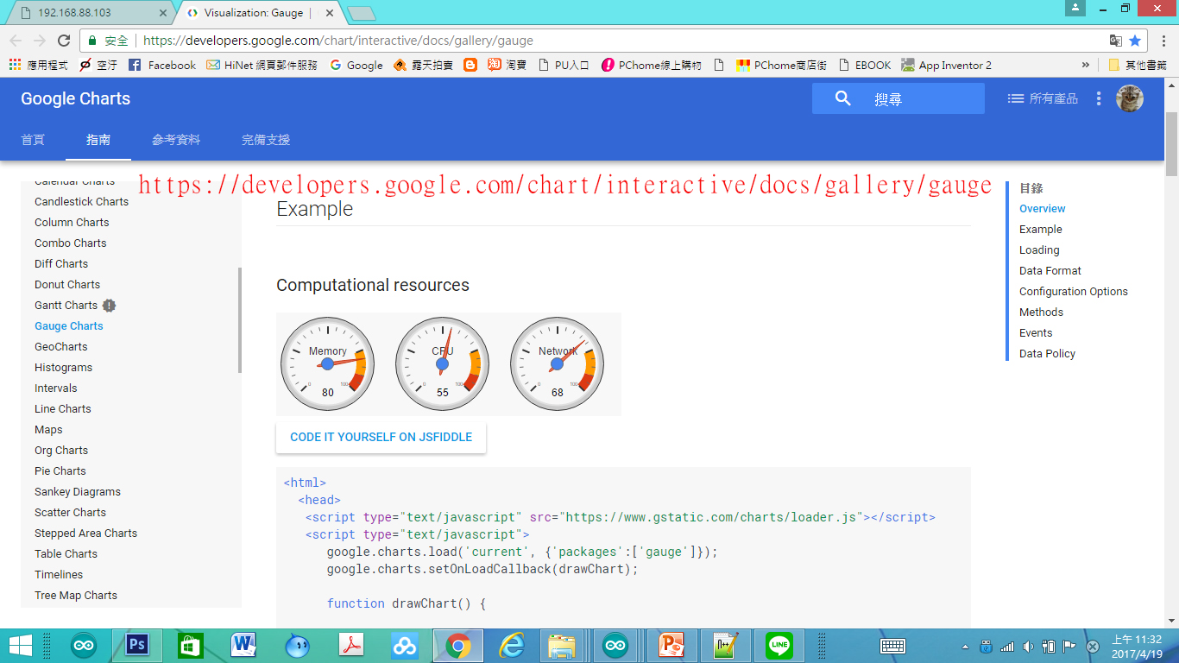
使用Google Developer資源
2017/11/2
69

Slide 70
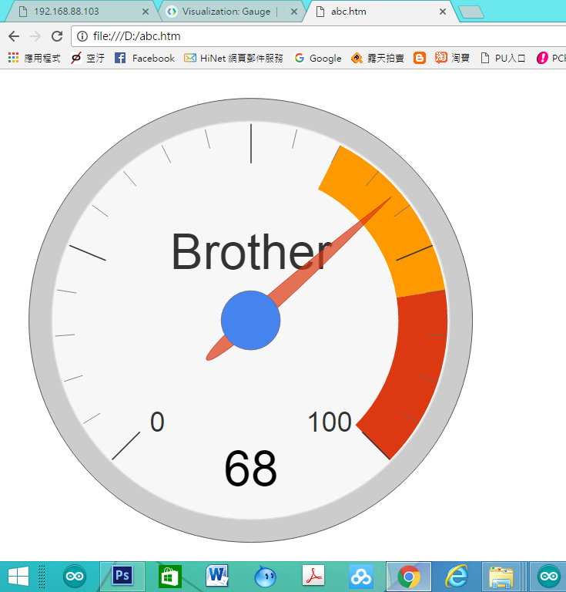
視覺化儀表板
2017/11/2
70

Slide 71
視覺化儀表板重點解說
<html>
<head>
<script type="text/javascript" src="https://www.gstatic.com/charts/loader.js"></script>
<script type="text/javascript">
google.charts.load('current', {'packages':['gauge']});
google.charts.setOnLoadCallback(drawChart);
使用Google 資源
載入Google Chart 資源
2017/11/2
71

Slide 72
視覺化儀表板重點解說
function drawChart() {
var data = google.visualization.arrayToDataTable([
['Label', 'Value'],
['Brother', 68]
]);
[‘Label’, ‘Value’]➔資料標題
第二列的[‘Brother’, 68] 為資料第一筆，
前面為資料名稱，後面資料內容
2017/11/2
72

Slide 73
視覺化儀表板重點解說
var options = {
width: 800, height: 800,
redFrom: 80, redTo: 100,
yellowFrom:60, yellowTo: 80,
minorTicks: 5
};
width: ， height 為 每一個Chart的寬與高
redFrom: 紅色區域開始, redTo:紅色區域結束
yellowFrom:黃色區域開始, yellowTo:黃色區域結束
minorTicks: 5 最小刻度
2017/11/2
73

Slide 74
視覺化儀表板重點解說
var chart = new google.visualization.Gauge(document.getElementById('chart_div'));
chart.draw(data, options);
var chart = new google.visualization.Gauge(document.getElementById(‘chart_div’))➔產生儀表板
chart.draw(data, options);➔畫出儀表板
2017/11/2
74

Slide 75
視覺化儀表板重點解說
<body>
<div id="chart_div" style="width: 800px; height: 800px;"></div>
</body>
<div id=“chart_div” style=“width: 800px; height: 800px;”></div>➔產生叫” chart_div”的 繪圖空間
width: 800px 繪圖空間寬度
height: 800px;繪圖空間高度
2017/11/2
75

Slide 76
視覺化儀表板 程式開發
2017/11/2
76

Slide 77
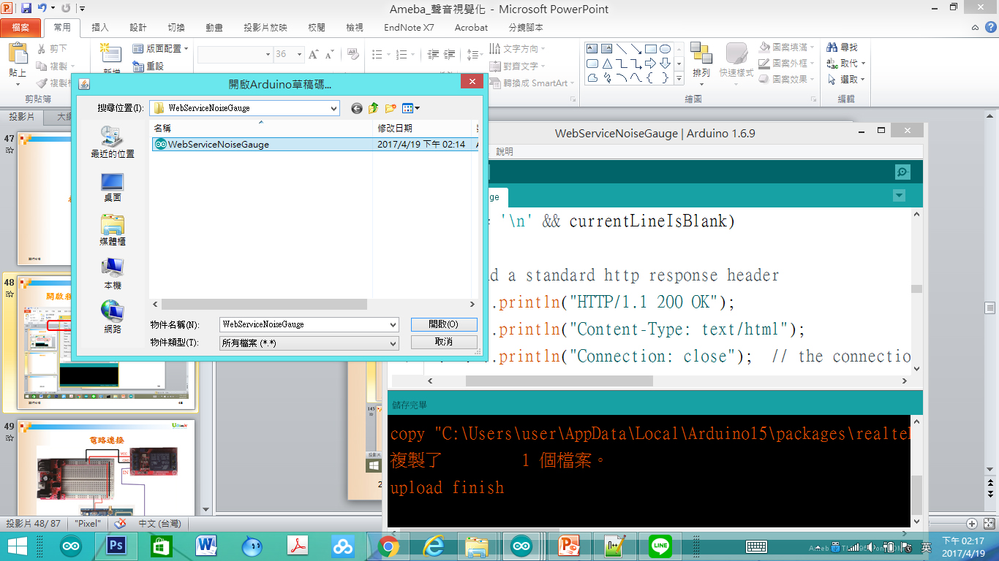
開啟程式DHT11_Pin7_WIFI_Server_Guage
2017/11/2
77

Slide 78
DHT11_Pin7_WIFI_Server_Guage
#include <WiFi.h>
// your network key Index number (needed only for WEP)
//-------------- dht use
#include "DHT.h"
#define DHTPIN 7 // what digital pin we're connected to
#define DHTTYPE DHT11 // DHT 11
2017/11/2
78
Notes:
#include <WiFi.h>
// your network key Index number (needed only for WEP)
//-------------- dht use
#include "DHT.h"
#define DHTPIN 7 // what digital pin we're connected to
#define DHTTYPE DHT11 // DHT 11
//#define DHTTYPE DHT22 // DHT 22 (AM2302), AM2321
//#define DHTTYPE DHT21 // DHT 21 (AM2301)
DHT dht(DHTPIN, DHTTYPE);
//----wifi use
uint8_t MacData[6];
char ssid[] = "BruceSonyC5"; // your network SSID (name)
char pass[] = "12345678"; // your network password
int keyIndex = 0;
IPAddress Meip , Megateway , Mesubnet ;
String MacAddress ;
int status = WL_IDLE_STATUS;
WiFiServer server(80);
//-----end of wifi use
void setup() /*----( SETUP: RUNS ONCE )----*/
{
Serial.begin(9600);
Serial.println("DHTxx test!");
dht.begin();
if (WiFi.status() == WL_NO_SHIELD) {
Serial.println("WiFi shield not present");
// don't continue:
while (true);
}
String fv = WiFi.firmwareVersion();
if (fv != "1.1.0") {
Serial.println("Please upgrade the firmware");
}
MacAddress = GetWifiMac() ; // get MacAddress
ShowMac() ; //Show Mac Address
// attempt to connect to Wifi network:
initializeWiFi();
server.begin();
// you're connected now, so print out the status:
ShowInternetStatus();
}// END Setup
static int count = 0;
void loop()
{
// Reading temperature or humidity takes about 250 milliseconds!
// Sensor readings may also be up to 2 seconds 'old' (its a very slow sensor)
float h = dht.readHumidity();
// Read temperature as Celsius (the default)
float t = dht.readTemperature();
// Read temperature as Fahrenheit (isFahrenheit = true)
float f = dht.readTemperature(true);
Serial.print("Humidity: ");
Serial.print(h);
Serial.print(" % and ");
Serial.print("Temperature: ");
Serial.print(t);
Serial.print(" *C ");
Serial.print(f);
Serial.print(" *F\t\n");
// wifi code here
// listen for incoming clients
WiFiClient client = server.available();
if (client)
{
Serial.println("Now Someone Access WebServer");
Serial.println("new client");
// an http request ends with a blank line
boolean currentLineIsBlank = true;
while (client.connected())
{
if (client.available())
{
char c = client.read();
Serial.write(c);
// if you've gotten to the end of the line (received a newline
// character) and the line is blank, the http request has ended,
// so you can send a reply
if (c == '\n' && currentLineIsBlank)
{
// send a standard http response header
client.println("HTTP/1.1 200 OK");
client.println("Content-Type: text/html");
client.println("Connection: close"); // the connection will be closed after completion of the response
client.println("Refresh: 5"); // refresh the page automatically every 5 sec
client.println();
client.println("<!DOCTYPE HTML>");
client.println("<html>");
// output the value of each analog input pin
client.println("<head>");
client.println("<script type='text/javascript' src='https://www.gstatic.com/charts/loader.js'></script>");
client.println("<script type='text/javascript'>");
client.println("google.charts.load('current', {'packages':['gauge']});");
client.println("google.charts.setOnLoadCallback(drawChart);");
client.println(" function drawChart() {");
client.println("var data = google.visualization.arrayToDataTable([['Label', 'Value'],['濕度',");
client.println(h);
client.println("],]);");
client.println(" var options = {width: 300, height: 300,redFrom: 90, redTo: 100,yellowFrom:75, yellowTo: 90,minorTicks: 5};");
client.println("var chart = new google.visualization.Gauge(document.getElementById('chart_div'));");
client.println("chart.draw(data, options);");
client.println("}");
client.println("</script>");
client.println("</head>");
client.println("<meta charset='utf-8'>");
client.println("<body>");
client.println("<div id='chart_div' style='width: 300px; height: 300px;'></div>");
client.println("</body>");
/*
client.print("Humidity: ");
client.print(h);
client.print(" % and ");
client.print("Temperature: ");
client.print(t);
client.print("*C and ");
client.print(f);
client.print("*F (end) ");
client.println("<br />");
*/
client.println("</html>");
break;
}
if (c == '\n')
{
// you're starting a new line
currentLineIsBlank = true;
} else if (c != '\r')
{
// you've gotten a character on the current line
currentLineIsBlank = false;
}
}
}
// give the web browser time to receive the data
delay(1);
// close the connection:
client.stop();
Serial.println("client disonnected");
}
delay(800) ;
} // END Loop
void ShowMac()
{
Serial.print("MAC:");
Serial.print(MacAddress);
Serial.print("\n");
}
String GetWifiMac()
{
String tt ;
String t1, t2, t3, t4, t5, t6 ;
WiFi.status(); //this method must be used for get MAC
WiFi.macAddress(MacData);
Serial.print("Mac:");
Serial.print(MacData[0], HEX) ;
Serial.print("/");
Serial.print(MacData[1], HEX) ;
Serial.print("/");
Serial.print(MacData[2], HEX) ;
Serial.print("/");
Serial.print(MacData[3], HEX) ;
Serial.print("/");
Serial.print(MacData[4], HEX) ;
Serial.print("/");
Serial.print(MacData[5], HEX) ;
Serial.print("~");
t1 = print2HEX((int)MacData[0]);
t2 = print2HEX((int)MacData[1]);
t3 = print2HEX((int)MacData[2]);
t4 = print2HEX((int)MacData[3]);
t5 = print2HEX((int)MacData[4]);
t6 = print2HEX((int)MacData[5]);
tt = (t1 + t2 + t3 + t4 + t5 + t6) ;
Serial.print(tt);
Serial.print("\n");
return tt ;
}
String print2HEX(int number) {
String ttt ;
if (number >= 0 && number < 16)
{
ttt = String("0") + String(number, HEX);
}
else
{
ttt = String(number, HEX);
}
return ttt ;
}
void printWifiData()
{
// print your WiFi shield's IP address:
Meip = WiFi.localIP();
Serial.print("IP Address: ");
Serial.println(Meip);
Serial.print("\n");
// print your MAC address:
byte mac[6];
WiFi.macAddress(mac);
Serial.print("MAC address: ");
Serial.print(mac[5], HEX);
Serial.print(":");
Serial.print(mac[4], HEX);
Serial.print(":");
Serial.print(mac[3], HEX);
Serial.print(":");
Serial.print(mac[2], HEX);
Serial.print(":");
Serial.print(mac[1], HEX);
Serial.print(":");
Serial.println(mac[0], HEX);
// print your subnet mask:
Mesubnet = WiFi.subnetMask();
Serial.print("NetMask: ");
Serial.println(Mesubnet);
// print your gateway address:
Megateway = WiFi.gatewayIP();
Serial.print("Gateway: ");
Serial.println(Megateway);
}
void ShowInternetStatus()
{
if (WiFi.status())
{
Meip = WiFi.localIP();
Serial.print("Get IP is:");
Serial.print(Meip);
Serial.print("\n");
}
else
{
Serial.print("DisConnected:");
Serial.print("\n");
}
}
void initializeWiFi() {
while (status != WL_CONNECTED) {
Serial.print("Attempting to connect to SSID: ");
Serial.println(ssid);
// Connect to WPA/WPA2 network. Change this line if using open or WEP network:
status = WiFi.begin(ssid, pass);
// status = WiFi.begin(ssid);
// wait 10 seconds for connection:
delay(10000);
}
Serial.print("\n Success to connect AP:") ;
Serial.print(ssid) ;
Serial.print("\n") ;
}

Slide 79
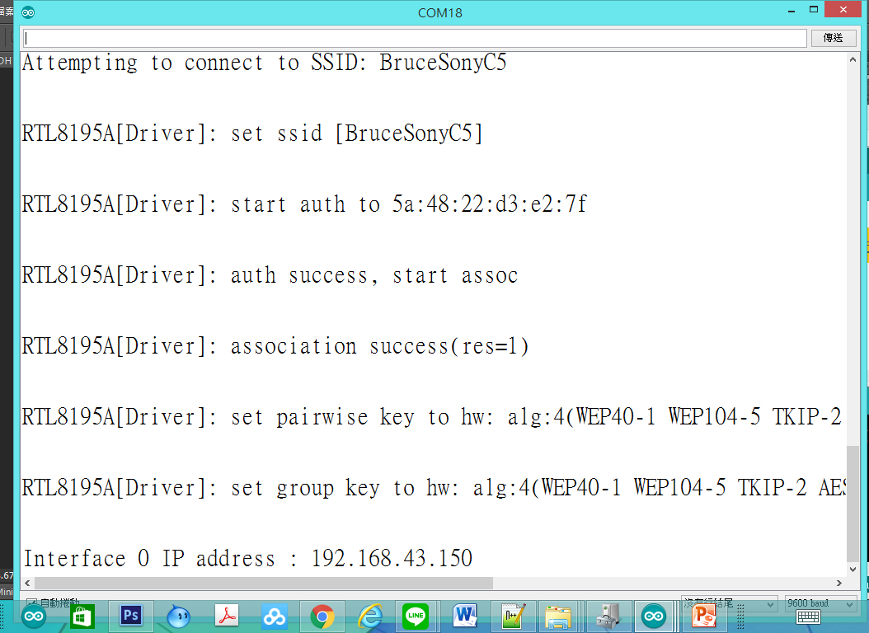
DHT11_Pin7_WIFI_Server_Guage監控畫面
2017/11/2
79

Slide 80
使用瀏覽器進入系統
1.先使用筆電或手機，使用wifi，並將ＷＩＦＩ熱點連接到與Ameba相同的熱點
2.進入瀏覽器(建議使用chrome)
3.網址列輸入上面IP(本例子為：http://192.168.43.150/
2017/11/2
80

Slide 81
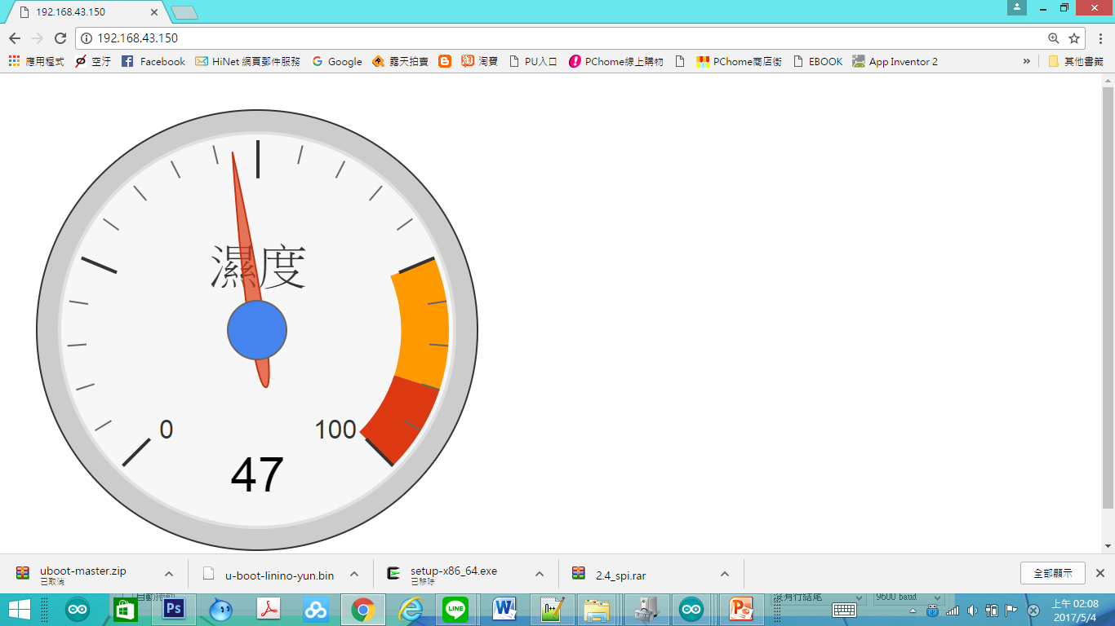
DHT11_Pin7_WIFI_Server_Guage網頁畫面
2017/11/2
81

Slide 82
自我練習
2017/11/2
82

Slide 83
習題
請將溫度、濕度的數值都讀出來
溫度顯示在一個Gauge 抬頭設為:SOUND”
黃色區域為55-80
紅色區域為80-100
2017/11/2
83

Slide 84
Q & A
感謝聆聽
恭請指教

Slide 85
練習解答
2017/11/2
85

Slide 86
開啟程式DHT11_Pin7_WIFI_Server_TwoGuage
2017/11/2
86

Slide 87
DHT11_Pin7_WIFI_Server_TwoGuage
#include <WiFi.h>
// your network key Index number (needed only for WEP)
//-------------- dht use
#include "DHT.h"
#define DHTPIN 7 // what digital pin we're connected to
#define DHTTYPE DHT11 // DHT 11
//#define DHTTYPE DHT22 // DHT 22 (AM2302), AM2321
//#define DHTTYPE DHT21 // DHT 21 (AM2301)
2017/11/2
87
Notes:
#include <WiFi.h>
// your network key Index number (needed only for WEP)
//-------------- dht use
#include "DHT.h"
#define DHTPIN 7 // what digital pin we're connected to
#define DHTTYPE DHT11 // DHT 11
//#define DHTTYPE DHT22 // DHT 22 (AM2302), AM2321
//#define DHTTYPE DHT21 // DHT 21 (AM2301)
DHT dht(DHTPIN, DHTTYPE);
//----wifi use
uint8_t MacData[6];
char ssid[] = "BruceSonyC5"; // your network SSID (name)
char pass[] = "12345678"; // your network password
int keyIndex = 0;
IPAddress Meip , Megateway , Mesubnet ;
String MacAddress ;
int status = WL_IDLE_STATUS;
WiFiServer server(80);
//-----end of wifi use
void setup() /*----( SETUP: RUNS ONCE )----*/
{
Serial.begin(9600);
Serial.println("DHTxx test!");
dht.begin();
if (WiFi.status() == WL_NO_SHIELD) {
Serial.println("WiFi shield not present");
// don't continue:
while (true);
}
String fv = WiFi.firmwareVersion();
if (fv != "1.1.0") {
Serial.println("Please upgrade the firmware");
}
MacAddress = GetWifiMac() ; // get MacAddress
ShowMac() ; //Show Mac Address
// attempt to connect to Wifi network:
initializeWiFi();
server.begin();
// you're connected now, so print out the status:
ShowInternetStatus();
}// END Setup
static int count = 0;
void loop()
{
// Reading temperature or humidity takes about 250 milliseconds!
// Sensor readings may also be up to 2 seconds 'old' (its a very slow sensor)
float h = dht.readHumidity();
// Read temperature as Celsius (the default)
float t = dht.readTemperature();
// Read temperature as Fahrenheit (isFahrenheit = true)
float f = dht.readTemperature(true);
Serial.print("Humidity: ");
Serial.print(h);
Serial.print(" % and ");
Serial.print("Temperature: ");
Serial.print(t);
Serial.print(" *C ");
Serial.print(f);
Serial.print(" *F\t\n");
// wifi code here
// listen for incoming clients
WiFiClient client = server.available();
if (client)
{
Serial.println("Now Someone Access WebServer");
Serial.println("new client");
// an http request ends with a blank line
boolean currentLineIsBlank = true;
while (client.connected())
{
if (client.available())
{
char c = client.read();
Serial.write(c);
// if you've gotten to the end of the line (received a newline
// character) and the line is blank, the http request has ended,
// so you can send a reply
if (c == '\n' && currentLineIsBlank)
{
// send a standard http response header
client.println("HTTP/1.1 200 OK");
client.println("Content-Type: text/html");
client.println("Connection: close"); // the connection will be closed after completion of the response
client.println("Refresh: 5"); // refresh the page automatically every 5 sec
client.println();
client.println("<!DOCTYPE HTML>");
client.println("<html>");
// output the value of each analog input pin
client.println("<head>");
client.println("<script type='text/javascript' src='https://www.gstatic.com/charts/loader.js'></script>");
client.println("<script type='text/javascript'>");
client.println("google.charts.load('current', {'packages':['gauge']});");
client.println("google.charts.setOnLoadCallback(drawChart);");
client.println(" function drawChart() {");
client.println("var data = google.visualization.arrayToDataTable([['Label', 'Value'],['hum',");
client.println(h);
client.println("],");
client.println("['Temp',");
client.println(t);
client.println("],]);");
client.println(" var options = {width: 300, height: 300,redFrom: 70, redTo: 100,yellowFrom:50, yellowTo: 70,minorTicks: 5};");
client.println("var chart = new google.visualization.Gauge(document.getElementById('chart_div'));");
client.println("chart.draw(data, options);");
client.println("}");
client.println("</script>");
client.println("</head>");
client.println("<meta charset='utf-8'>");
client.println("<body>");
client.println("<div id='chart_div' style='width: 300px; height: 300px;'></div>");
client.println("</body>");
/*
client.print("Humidity: ");
client.print(h);
client.print(" % and ");
client.print("Temperature: ");
client.print(t);
client.print("*C and ");
client.print(f);
client.print("*F (end) ");
client.println("<br />");
*/
client.println("</html>");
break;
}
if (c == '\n')
{
// you're starting a new line
currentLineIsBlank = true;
} else if (c != '\r')
{
// you've gotten a character on the current line
currentLineIsBlank = false;
}
}
}
// give the web browser time to receive the data
delay(1);
// close the connection:
client.stop();
Serial.println("client disonnected");
}
delay(800) ;
} // END Loop
void ShowMac()
{
Serial.print("MAC:");
Serial.print(MacAddress);
Serial.print("\n");
}
String GetWifiMac()
{
String tt ;
String t1, t2, t3, t4, t5, t6 ;
WiFi.status(); //this method must be used for get MAC
WiFi.macAddress(MacData);
Serial.print("Mac:");
Serial.print(MacData[0], HEX) ;
Serial.print("/");
Serial.print(MacData[1], HEX) ;
Serial.print("/");
Serial.print(MacData[2], HEX) ;
Serial.print("/");
Serial.print(MacData[3], HEX) ;
Serial.print("/");
Serial.print(MacData[4], HEX) ;
Serial.print("/");
Serial.print(MacData[5], HEX) ;
Serial.print("~");
t1 = print2HEX((int)MacData[0]);
t2 = print2HEX((int)MacData[1]);
t3 = print2HEX((int)MacData[2]);
t4 = print2HEX((int)MacData[3]);
t5 = print2HEX((int)MacData[4]);
t6 = print2HEX((int)MacData[5]);
tt = (t1 + t2 + t3 + t4 + t5 + t6) ;
Serial.print(tt);
Serial.print("\n");
return tt ;
}
String print2HEX(int number) {
String ttt ;
if (number >= 0 && number < 16)
{
ttt = String("0") + String(number, HEX);
}
else
{
ttt = String(number, HEX);
}
return ttt ;
}
void printWifiData()
{
// print your WiFi shield's IP address:
Meip = WiFi.localIP();
Serial.print("IP Address: ");
Serial.println(Meip);
Serial.print("\n");
// print your MAC address:
byte mac[6];
WiFi.macAddress(mac);
Serial.print("MAC address: ");
Serial.print(mac[5], HEX);
Serial.print(":");
Serial.print(mac[4], HEX);
Serial.print(":");
Serial.print(mac[3], HEX);
Serial.print(":");
Serial.print(mac[2], HEX);
Serial.print(":");
Serial.print(mac[1], HEX);
Serial.print(":");
Serial.println(mac[0], HEX);
// print your subnet mask:
Mesubnet = WiFi.subnetMask();
Serial.print("NetMask: ");
Serial.println(Mesubnet);
// print your gateway address:
Megateway = WiFi.gatewayIP();
Serial.print("Gateway: ");
Serial.println(Megateway);
}
void ShowInternetStatus()
{
if (WiFi.status())
{
Meip = WiFi.localIP();
Serial.print("Get IP is:");
Serial.print(Meip);
Serial.print("\n");
}
else
{
Serial.print("DisConnected:");
Serial.print("\n");
}
}
void initializeWiFi() {
while (status != WL_CONNECTED) {
Serial.print("Attempting to connect to SSID: ");
Serial.println(ssid);
// Connect to WPA/WPA2 network. Change this line if using open or WEP network:
status = WiFi.begin(ssid, pass);
// status = WiFi.begin(ssid);
// wait 10 seconds for connection:
delay(10000);
}
Serial.print("\n Success to connect AP:") ;
Serial.print(ssid) ;
Serial.print("\n") ;
}

Slide 88
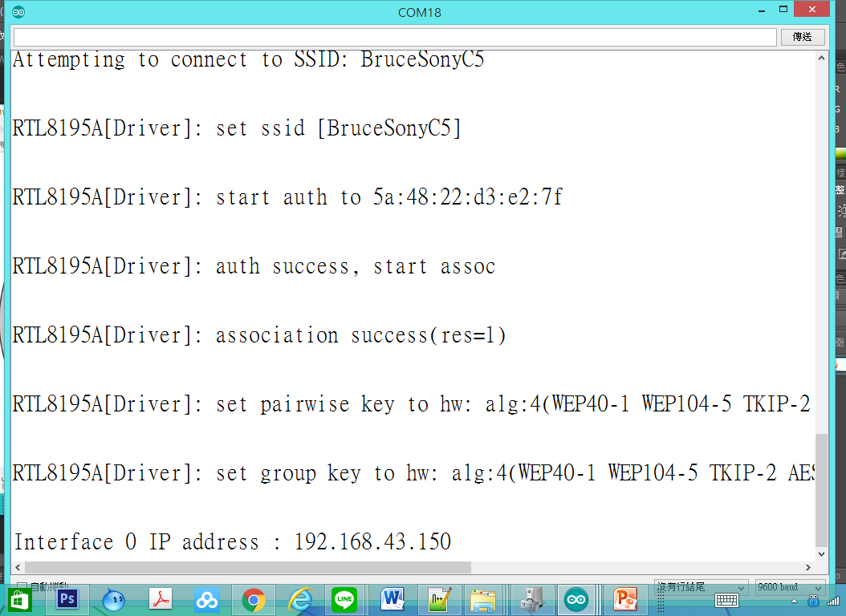
DHT11_Pin7_WIFI_Server_TwoGuage監控畫面
2017/11/2
88

Slide 89
使用瀏覽器進入系統
1.先使用筆電或手機，使用wifi，並將ＷＩＦＩ熱點連接到與Ameba相同的熱點
2.進入瀏覽器(建議使用chrome)
3.網址列輸入上面IP(本例子為：http://192.168.43.150/
2017/11/2
89

Slide 90
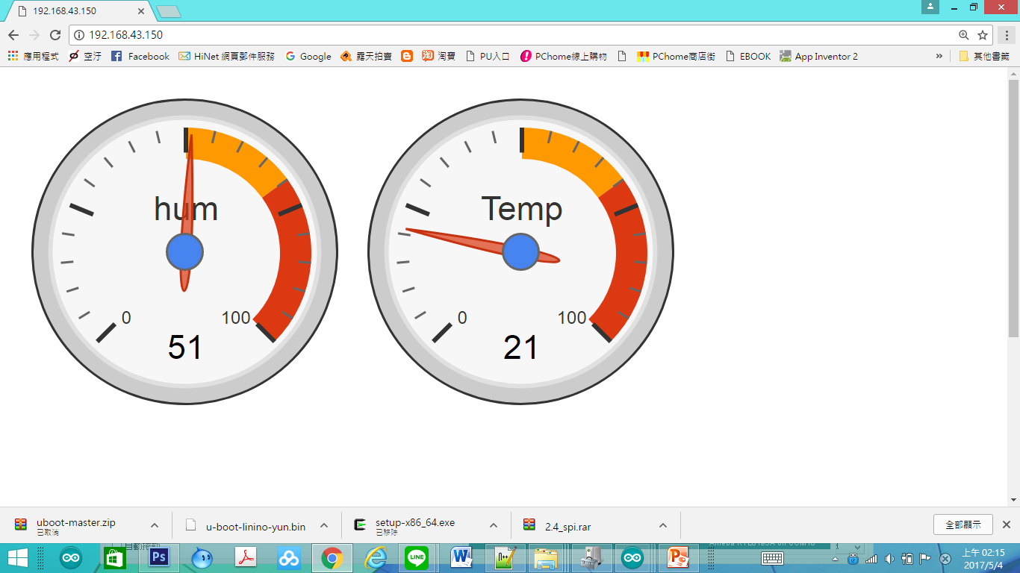
DHT11_Pin7_WIFI_Server_TwoGuage網頁畫面
2017/11/2
90

